Slide 1
Detective Notebook

Slide 2
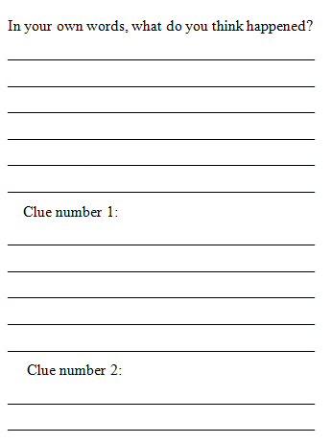
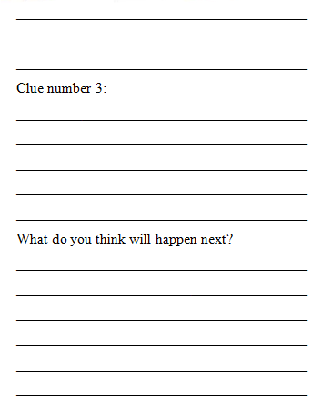
How to read it…

Slide 3
Let’s Practice!(page 1)
Her lip slightly sneered, she slowly removed the chewed, sticky mint gum from her mouth with the perfectly painted nails of her thumb and index finger. She rolled the wad around with fingers, letting the warm saliva go cold before placing it firmly in the hair of the unassuming girl seated in front of her. She tilted her head slightly to the right, her teeth beginning to show behind her lips, and admired her work.

Slide 4
More Practice (page 2)
I could hear its decaying breath from down the hall. I hugged the cabinet, my arms tense and the blood running freely on my knee, as I inched toward the open doorway. A crash of pots and pans and a low guttural grunt reached out at me as I froze in horror. I could hear the slow shuffle scrap the pans as my mission limped toward me.

Slide 5
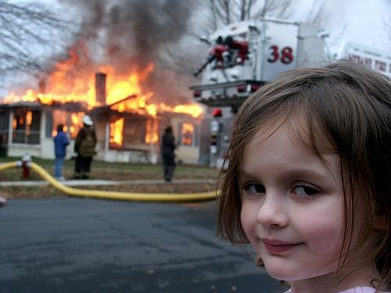
More Practice (page 3)

