Slide 1
VOCABULARY
Purpose | To inform, persuade, entertain, or explain something.
Audience | Who the writing is intended for.
Speaker | The imaginary voice assumed by the writer

Slide 2
The 3 Appeals of Persuasion | Explanation | Presenter Appeals to…
ETHOS | Ethics. (“I am an authority and I’m telling you it’s the right thing to do!”) | Reputation of Speaker
PATHOS | Passion. (Fear, love, jealousy). | Feelings
LOGOS | Logic. (Facts, data, science) | Facts

Slide 3
What makes this persuasive? What are they trying to persuade you to believe?
L

Slide 4
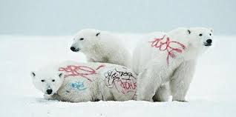
Ethos, Pathos or Logos?

Slide 5
Ethos, Pathos or Logos?

Slide 6
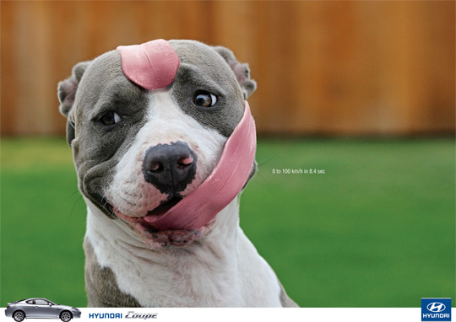
Ethos, Pathos or Logos?

Slide 7
Ethos, Pathos or Logos?

Slide 8
Ethos,
Pathos,
or
Logos?

Slide 9
Ethos, Pathos or Logos?

Slide 10
LET’S
PRACTICE!
☺

Slide 11
1. Ethos, Pathos or Logos?

Slide 12
2. Ethos, Pathos or Logos?

Slide 13
3. Ethos, Pathos or Logos?

Slide 14
4. Ethos, Pathos or Logos?

Slide 15
5. Ethos, Pathos or Logos?

Slide 16
6. Ethos, Pathos or Logos?

Slide 17
7. Ethos, Pathos or Logos?

Slide 18
8. Ethos, Pathos or Logos?

