Slide 1
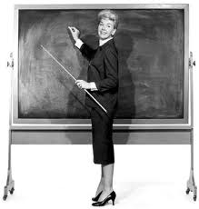

Slide 2
Hi There…
My name is Jeanine…
I am your new English SGI Teacher…
Let me tell you a little about myself…

Slide 3
I am a Writer…..
I have written several children’s
Books…
I have also been a Ghost writer…

Slide 4
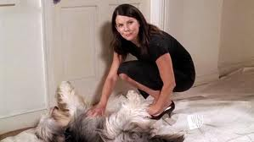
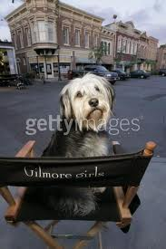
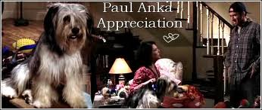
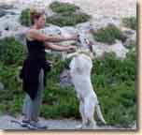
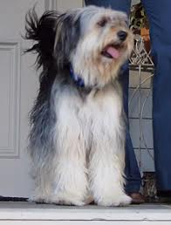
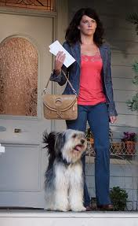
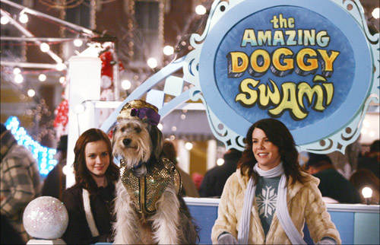
I trained animals for Film and Television for 15 years…
Sparky and I worked on the Gilmore Girls for four years…

Slide 5
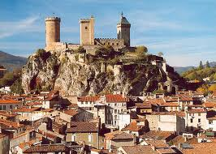
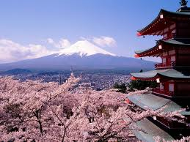
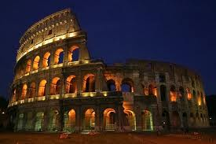
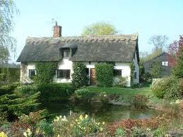
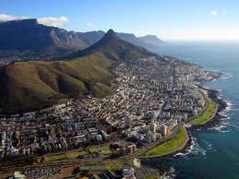
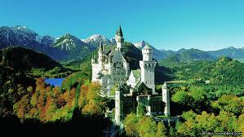
I Have Worked in Some Really Cool Places…
Can You Guess Where?
France
Italy
Japan
Germany
South Africa
England

Slide 6
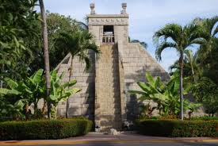
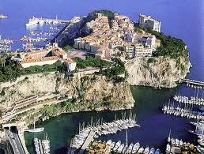
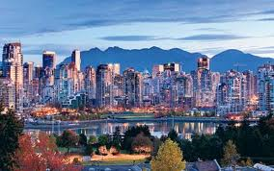
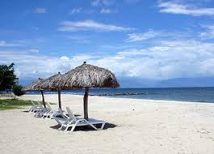
I Have Worked in Some Really Cool Places…
Mexico
Monaco
Canada
Jamaica

Slide 7
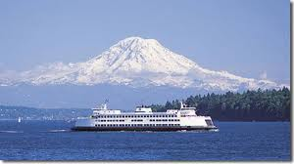
I was also born in a really cool place…
Seattle, Washington

Slide 8
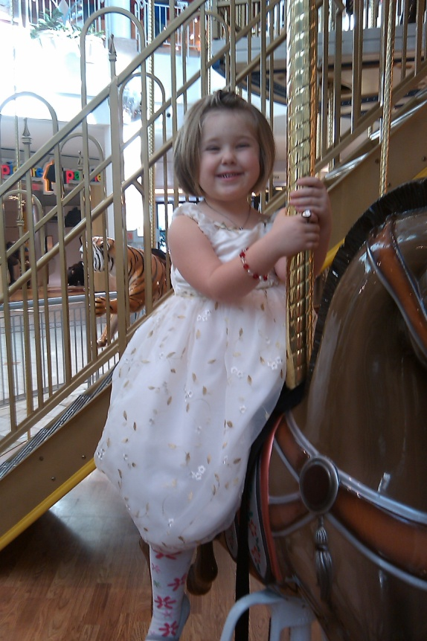
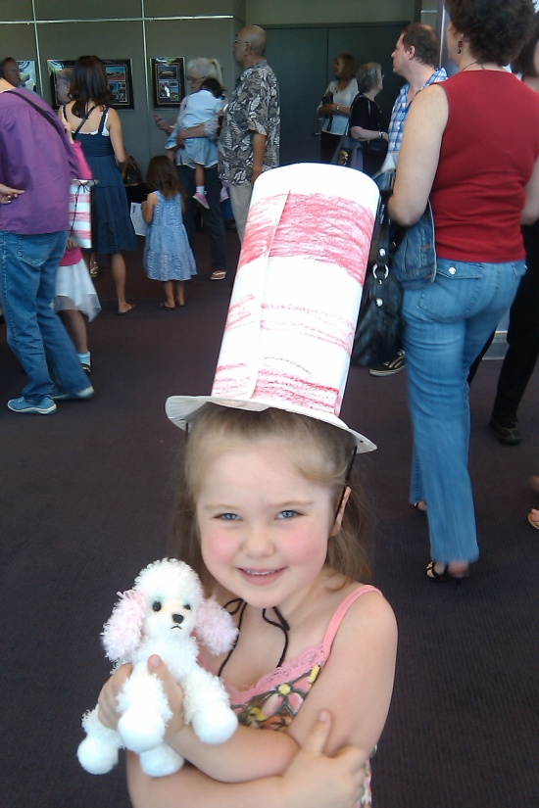
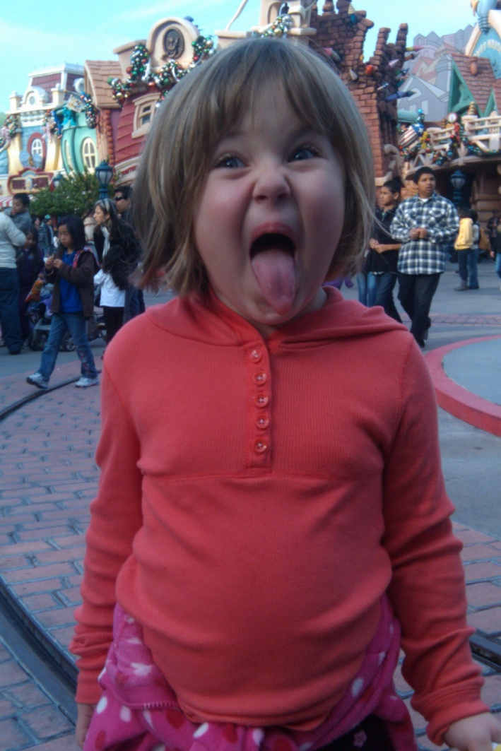
My most important job though, is being a Mom…

Slide 9
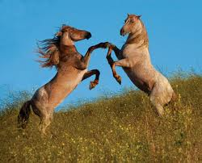
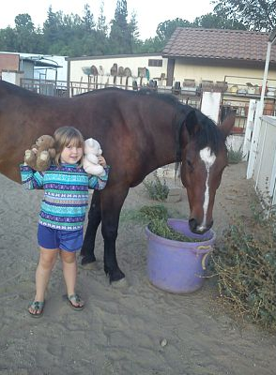
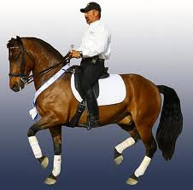
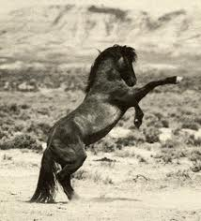
I am also really into horses…
…especially American Mustangs ..
This is our Mustang, Kaya ☺

Slide 10
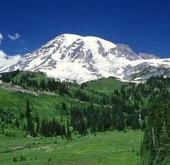
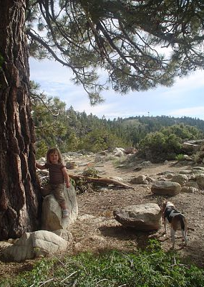
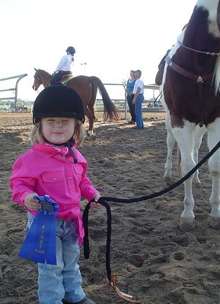
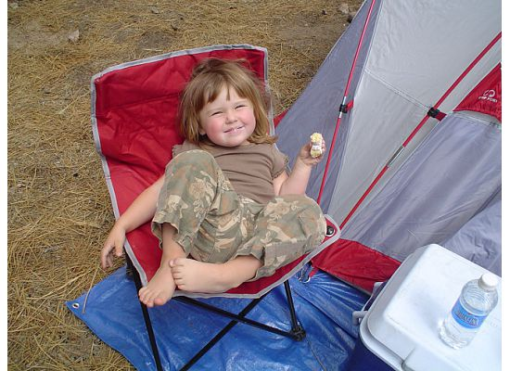
Some of my Favorite Things To Do Are…
Going Hiking
Going to The Beach
Going to The Mountains
And Camping
Taking my daughter to horse shows

Slide 11
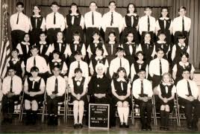
But Enough About Me….
Tell Me About You….

Slide 12
Write Your Name and ONE Interesting Fact About Yourself on Your Card… (example)
Suzy Student
I love to snowboard…
I will be collecting these to use later…

Slide 13
Meet your neighbors…
Interview three people and write down their name and their cool fact…

Slide 14
Game Time!!!
I will read a cool fact from the cards.
If you recognize this fact from one of your classmates raise your hand.
Winners get a prize (Yay!)

